Slide 1







Enterprise Blockchain Developers (Intermediate)
In support of
Powered By

Slide 2
Outline
Introduction to Uniswap App
How To Fork Uniswap
RISmarket-NFT Example
Aave Example
© 2017-2020 SmartMesh Foundation Pte. Ltd. | MeshBox Foundation Pte. Ltd.

Slide 3
Introduction to Uniswap App
What is Uniswap? Dex
Bond cruving
automatic market making
Bond curving vs matching engine
Pros and Cons
risky for the market maker?
need liqudity pool?
easy to use for inidvidual traders

Slide 4
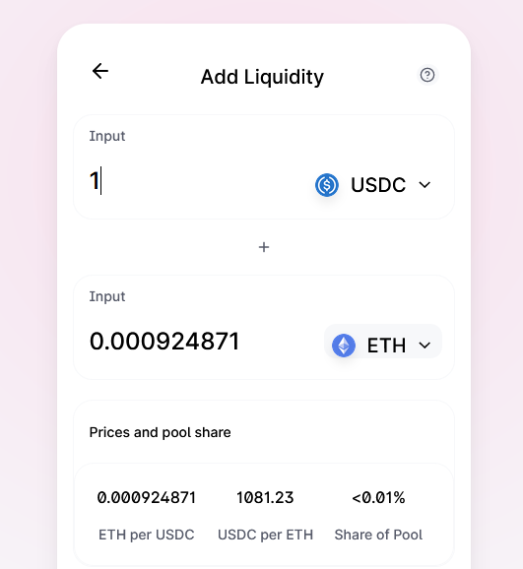
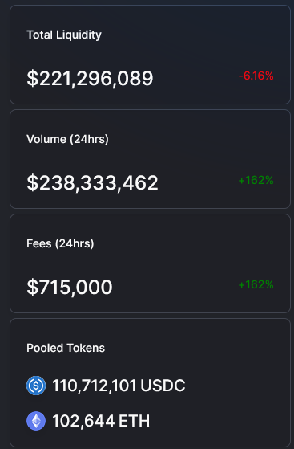
Liqudity Pool

Slide 5
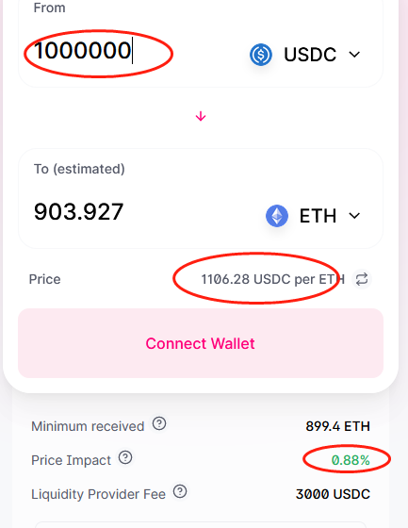
Swap

Slide 6
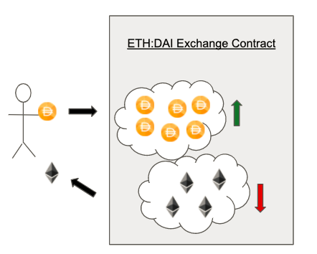
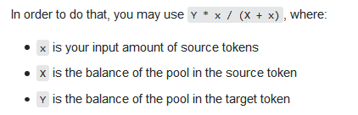
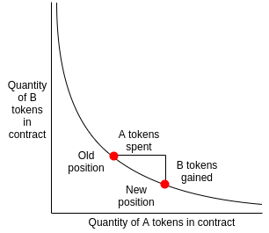
Liqudity Pool
How to price the token

Slide 7
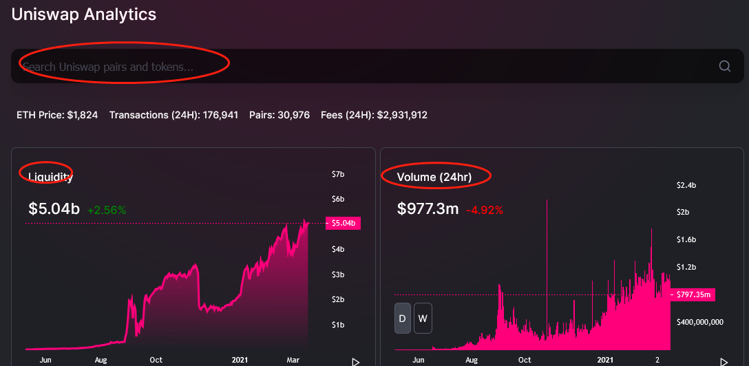
Uniswap Info
uniwswap.info

Slide 8
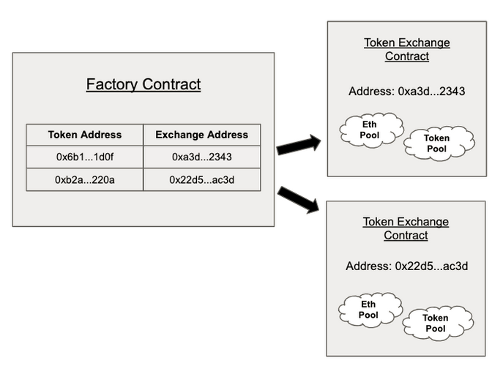
Overview of Uniswap’s Contracts
Exchange contract: Exchange contracts hold a pool of a specific token and Ether that users can swap against.
Factory contract which is in charge of creating new Exchange contracts and registering the ERC20 token address to its Exchange contract address.

Slide 9
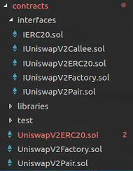
Uniswap Contracts Introduction
2 main repositories:
Uniswap-Core
Periphery
Uniswap-Core: create trading pair contracts using factory
1. UniswapV2ERC20.sol: liqudity token, when deposite TokenA and
TokenB, the trading pair contract will generate this token as your
liqudity deposite receipt
2. UniswapV2Pair.sol: trading pair contract
3. UniswapV2Factory: the factory contract to generate trading pair
contract (trading venue)
(Code Explain)

Slide 10
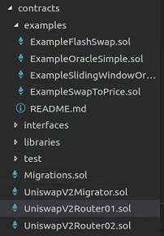
Uniswap Contracts Introduction
2 main repositories:
Uniswap-Core
Periphery
Periphery: providing tools
1. Uniswapt: migrate liquidity pools from v1
2. Router01: smart contract to trade
(Code Explain)

Slide 11
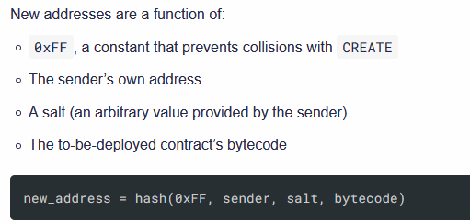
Uniswap Contracts
The CREATE2 opcode gives us the ability predict the address where a contract will be deployed, without ever having to do so
IUniswapV2Pair(pair).initialize(token1,token2) : when you call functions on that contract, they should be sent to the address pair.
use type(aa).creationCode to create a new contract
keccak256(bytes memory) returns (bytes32) − computes the Keccak-256 hash of the input.

Slide 12
Uniswap Fork Demo
Demo

